Slide 1

TARGET FOLDER
SRNTGT046
Apatite Steel Production Facility, SRN
SECRET - DCS WORLD
REL TO COALITION
SECRET - DCS WORLD
REL TO COALITION

Slide 2

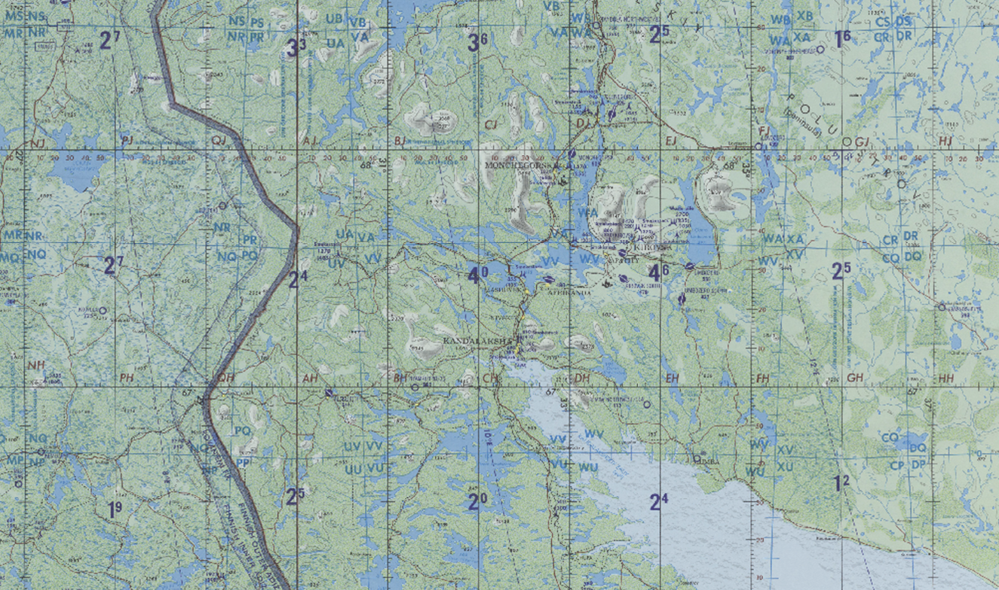
Apatite Steel Production Facility, SRN
OPAC CLASSIFIED REL TO CJTF-23
JOINT OPERATIONS GRAPHIC 1
MAP
OVERVIEW
BE: SRNTGT046 CATCODE: 9
MIDB GEO: N 67 36.462 E 033 24.820
ICOD: 2011-JUL-21 DOI:2010-DEC-11
DECL ON: 2061-JUL-21
N
.
Apatite Steel Production Facility SRNTGT046

Slide 3
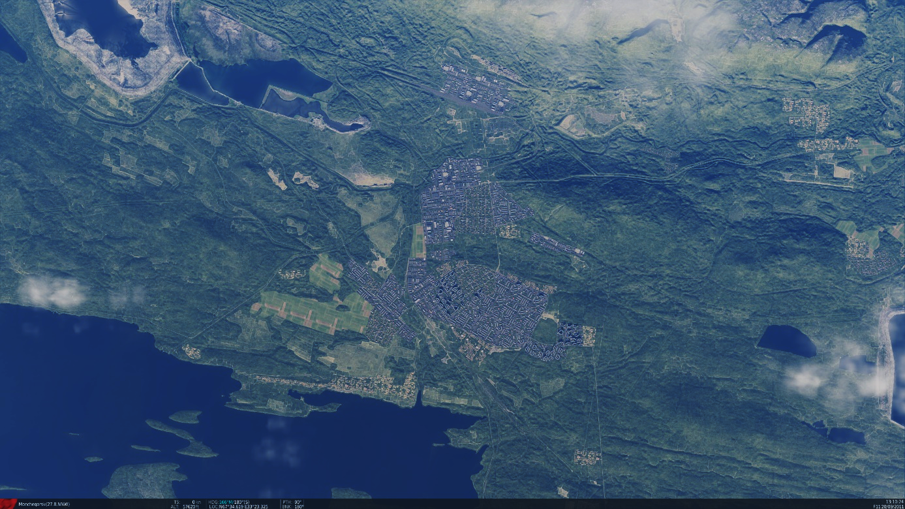
Apatite Steel Production Facility, SRN
OPAC CLASSIFIED REL TO CJTF-23
FACILITY OUTLINE GRAPHIC 1/1
MAP
OVERVIEW
BE: SRNTGT046 CATCODE: 9
MIDB GEO: N 67 36.462 E 033 24.820
ICOD: 2011-JUL-21 DOI:2010-DEC-11
DECL ON: 2061-JUL-21
N
Apatite Steel Production Facility SRNTGT046
Apatite SAM Factory
SRNTGT072

Slide 4
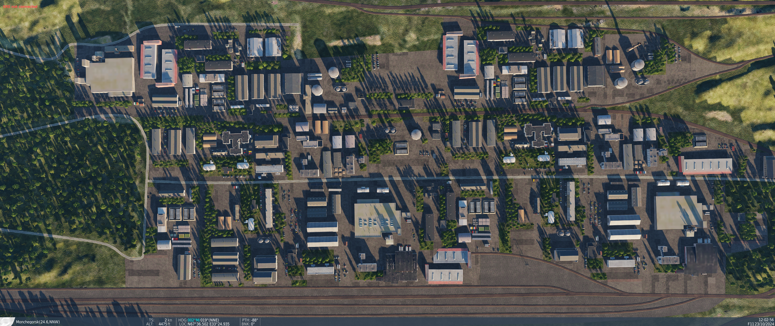
Apatite Steel Production Facility, SRN
OPAC CLASSIFIED REL TO CJTF-23
DESIRED POINT OF IMPACT GRAPHIC 1/1
MAP
OVERVIEW
BE: SRNTGT046 CATCODE: 9
MIDB GEO: N 67 36.462 E 033 24.820
ICOD: 2011-JUL-21 DOI:2011-JUN-20
DECL ON: 2061-JUL-21
N
DPI : SRNTGT046-D
TERSIASY PRODUCTION FACILITY
N 67 36.560 E 033 25.039
DPI MSL: 550 FT
DPI : SRNTGT046-G
OXYGEN STORAGE FOR PRODUCTION
N 67 36.510 E 033 25.156
DPI MSL: 530 FT
DPI : SRNTGT046-C
TERSIASY PRODUCTION FACILITY
N 67 36.645 E 033 25.039
DPI MSL: 550 FT
DPI : SRNTGT046-F
OXYGEN STORAGE FOR PRODUCTION
N 67 36.497 E 033 25.118
DPI MSL: 530 FT
DPI : SRNTGT046-A
MAIN PRODUCTION FACILITY
N 67 36.522 E 033 25.112
DPI MSL: 550 FT
DPI : SRNTGT046-E
POWER FOR PRODUCTION
N 67 36.510 E 033 25.012
DPI MSL: 550 FT
DPI : SRNTGT046-B
SECONDARY PRODUCTION FACILITY
N 67 36.475 E 033 25.062
DPI MSL: 550 FT

Slide 5
Apatite Steel Production Facility, SRN
OPAC CLASSIFIED REL TO CJTF-23
WEAPONEERING OPTIONS 1/1
MAP
OVERVIEW
BE: SRNTGT046 CATCODE: 9
MIDB GEO: N 67 36.462 E 033 24.820
ICOD: 2011-JUL-21 DOI:2010-DEC-11
DECL ON: 2061-JUL-21
DPI | DESCRIPTION | TLE | WARHEAD | GUIDANCE | DESIRED EFFECT | IMPACT ANGLE | FUZING
A | MS CONCRETE/BRICK FACTORY WITH SQUARE STACKS | CAT 3 | 2000 lbs | DECIMETRIC | BLAST | 60-90 | 25ms
B | MS STRUCTURE STEEL CLAD FACTORY | CAT 3 | 1000 lbs | DECIMETRIC | BLAST | 60-90 | 25ms
C | MS CONCRETE/BRICK BUILDING | CAT 3 | 1000 lbs | METRIC | BLAST | 60-90 | 25ms
D | MS CONCRETE/BRICK BUILDING | CAT 3 | 1000 lbs | METRIC | BLAST | 60-90 | 25ms
E | MS BRICK POWER DISTRIBUTION BUILDING | CAT 3 | 1000 lbs | METRIC | BLAST | 60-90 | 25ms
F | 16 TANK REVETTED LIQUID/GAS STORAGE CONTAINERS | CAT 3 | 1000 lbs | METRIC | BLAST | 60-90 | 0ms
G | 16 TANK REVETTED LIQUID/GAS STORAGE CONTAINERS | CAT 3 | 1000 lbs | METRIC | BLAST | 60-90 | 0ms

Slide 6
Apatite Steel Production Facility, SRN
OPAC CLASSIFIED REL TO CJTF-23
COLLATERAL DAMAGE ESTIMATION GRAPHIC 1/1
MAP
OVERVIEW
BE: SRNTGT046 CATCODE: 9
MIDB GEO: N 67 36.462 E 033 24.820
ICOD: 2011-JUL-21 DOI:2010-DEC-11
DECL ON: 2061-JUL-21
N
CER 250M / 812FT
CHEM STORAGE <100m from DPI-C
Appartment Building <200m from DPI-G
DPI C
DPI G
FUEL STORAGE <200m from DPI-G
CDE 5: CJTF HQ APPROVAL REQUIRED. CHEMICAL SPILLAGE FROM STRIKE IS POSSIBLE AND MIGHT REACH APATITY (0.8NM SOUTH)

Slide 7
Apatite Steel Production Facility, SRN
OPAC CLASSIFIED REL TO CJTF-23
COLLATERAL DAMAGES ESTIMATION 1/1
MAP
OVERVIEW
BE: SRNTGT046 CATCODE: 9
MIDB GEO: N 67 36.462 E 033 24.820
ICOD: 2011-JUL-21 DOI:2010-DEC-11
DECL ON: 2061-JUL-21
COLLATERAL DAMAGES WITHIN A 500M RADIUS
DESCRIPTION |  | CATCODE | MIDB GEOS | LOCATION | REMARKS
Apartment Building |  | 14 |  |  | Civilian Casualties.
Chemical Storage |  | 1 |  |  | Chemical spills
Fuel Storage |  | 14 |  |  | Fuel storage might cause secondary damages
NO STRIKE ENTITIES WITHIN A 500M RADIUS
NSE ID | DESCRIPTION | CATCODE | MIDB GEOS | LOCATION | REMARKS

Slide 8
Apatite Steel Production Facility, SRN
OPAC CLASSIFIED REL TO CJTF-23
BATTLE DAMAGE ASSESSMENT GRAPHIC 1
MAP
OVERVIEW
BE: SRNTGT046 CATCODE: 9
MIDB GEO: N 67 36.462 E 033 24.820
ICOD: 2011-JUL-21 DOI:2010-DEC-11
DECL ON: 2061-JUL-21
POST-STRIKE
PRE-STRIKE
N
TARGET OBJECTIVE
DAMAGE/CHANGE ASSESSMENT
DPI:[XXXXXX]
BDA REMARK: [CLASSIFICATION] [DISSEMINATION] Assessment: Physical Damage/change, Collateral Damage, Functional Damage/change, Munitions Effectiveness, Reattack Recommendation, Additional/Collateral Effects

Slide 9

ACRONYMS
ACRONYM | MEANING | DEFINITION
BE | Basic Encyclopedia Number | Alpha/numeric code unique to an installation for incorporation within various national and tactical systems.
CATCODE | Category Code | The data Element that classifies the function and purpose of an installation or a facility.
MIDB | Modernized Integrated Database | A database comprised of information on facilities of military significance, military forces, and related equipment.
ICOD | Intelligence Cut Off Date | The date of the latest intelligence data inputted to a feature.
DOI | Date of Image | Date on which a geospatial or intelligence-related image was captured.
CE | Critical Element | An element of an entity or object that enables it to perform its primary function.
PV CHAR | Physical Vulnerability Characteristic | Standardized alphanumeric code describing the physical and structural properties of a target.
JDPI | Joint Desired Point of Impact | A unique, alphanumeric coded aimpoint identified by a three dimensional mensurated point. It represents a weapon or capability desired point of impact or penetration.
CE90 | Circular Error at 90% | 90 percent confidence level in the horizontal plane.
LE90 | Linear Error at 90% | 90 percent confidence level in the vertical dimension
MSL | Mean Sea Level | Elevation above Earth reference geoid.
AGL | Above Ground Level | Elevation above ground surface.
NCC | Nearest Collateral Concern | Closest non-targeted structure, area, or entity near a planned point of impact that may be at risk of unintended damage during a military strike.
CER | Collateral effects radius | Radius within which collateral damage might happen based on the weapon's characteristics, the target environment, and other operational factors.
CDE | Collateral damage estimate | Systematic process used in military targeting to evaluate the potential for unintended damage or harm to non-combatant entities, structures, or personnel as a result of a planned strike.
NSE | No Strike Element | Specific entities, locations, or objects that are protected from intentional targeting under the Law of Armed Conflict (LOAC) or by operational policy.

